Slide 1
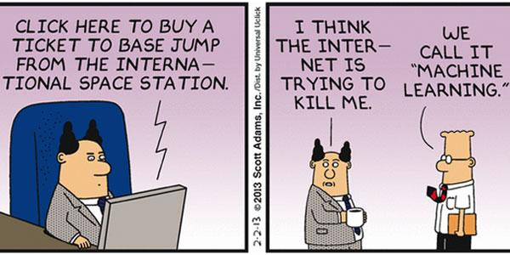
ML On Spark, UC Berkeley
Yushu Yao

Slide 2
Plans for today
Machine Learning basics
Spark transformations and actions
Hands on: SDSS dataset
Form Groups by week 3 of lecture

Slide 3

What is Machine Learning

Slide 4
Machine Learning Algorithms?

Slide 5
Types of Algorithms (and bottlenecks) Aggregations, GNPs, graphical models, linear algebra, optimization
Querying: nearest-neighbor O(N), spherical range-search O(N), orthogonal range-search O(N), contingency table
Density estimation: kernel density estimation O(N²), mixture of Gaussians O(N)
Regression: linear regression O(D³), kernel regression O(N²), Gaussian process regression O(N³)
Classification: nearest-neighbor classifier O(N²), nonparametric Bayes classifier O(N²), support vector machine
Dimension reduction: principal component analysis O(D³), non-negative matrix factorization, kernel PCA O(N³), maximum variance unfolding O(N³)
Outlier detection: by robust L₂ estimation, by density estimation, by dimension reduction
Clustering: k-means O(N), hierarchical clustering O(N³), by dimension reduction
Time series analysis: Kalman filter O(D³), hidden Markov model, trajectory tracking
2-sample testing: n-point correlation O(N^{n})
Cross-match: bipartite matching O(N³)
Courtesy of Alex Gray @ Skytree

Slide 6

Supervised Learning

Slide 7
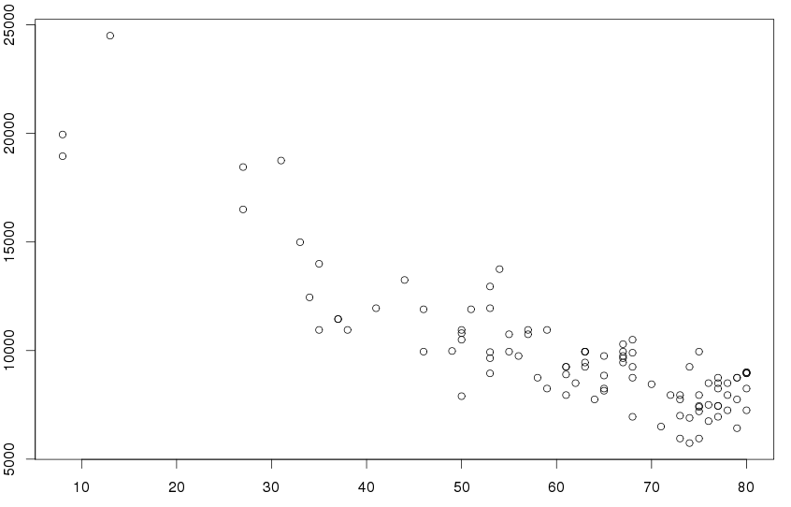
Regression
Price
Age of Car (month)
Given a "labeled" dataset ("training set", label: price, feature: age)
Predict a how much you can sell your car for (Price is continuous value)

Slide 8
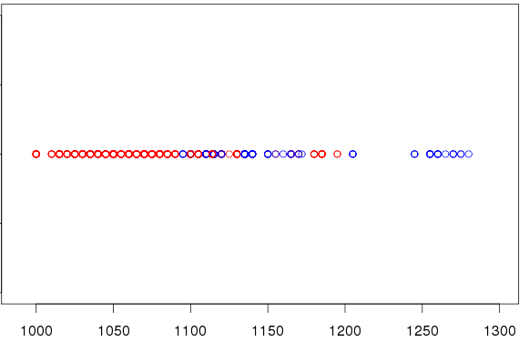

Classification (1-Variable)
o: Petrol
o: Diesel
Petrol
Diesel
Weight of Car (kg)
Given a "labeled" dataset ("training set", label: type, feature: weight)
Predict if a car is diesel or Petrol (Classify to different categories)

Slide 9
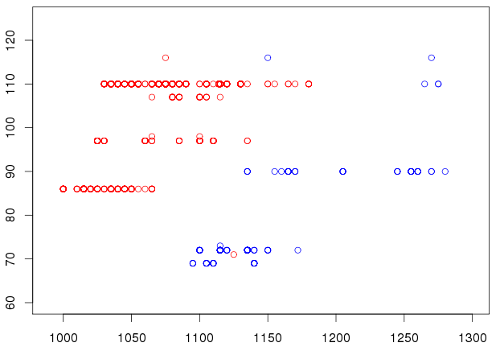
Classification (Multivariable)
o: Petrol
o: Diesel
Horsepower
Weight of Car (kg)
label: type, feature: (weight, horsepower)

Slide 10
Unsupervised Learning

Slide 11
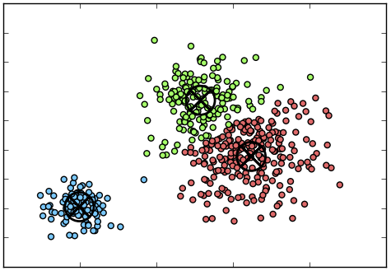
Clustering
Amount Money Spent
Amount of time Spent Play a game
Given an "unlabeled" dataset (feature: time,money)
Find out if these users group into clusters
Notes:
Money spent vs time spent

Slide 12
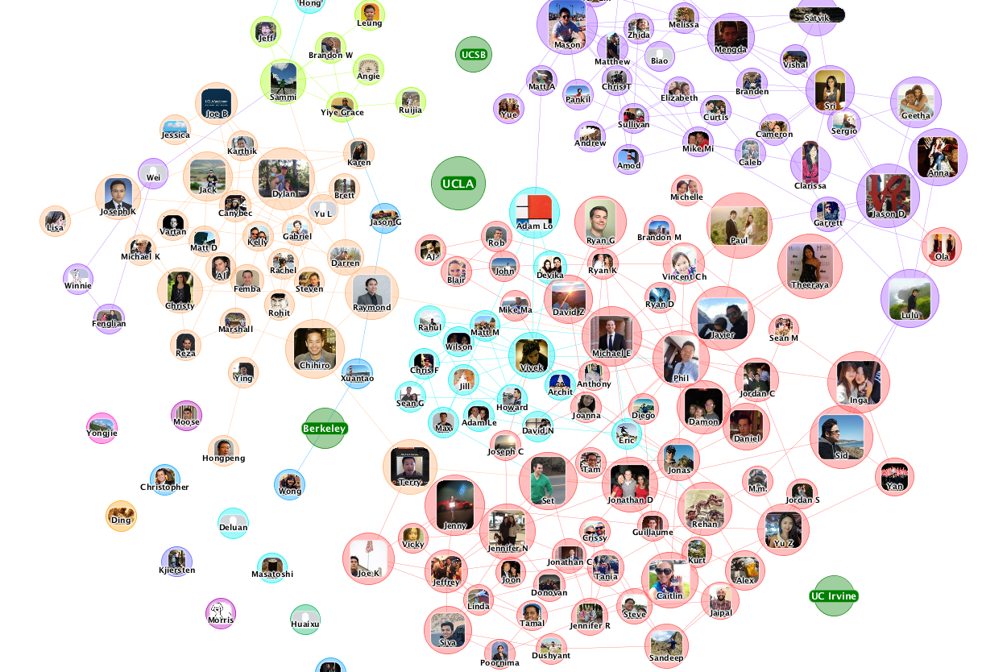
Network/Graph Analysis

Slide 13
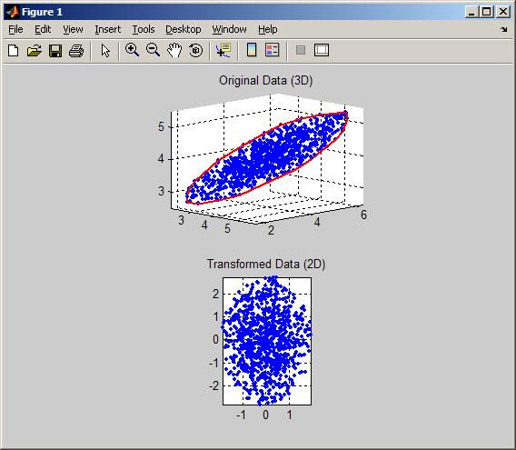
Dimensionality Reduction
3D Dataset (x,y,z)
2D Dataset (x', y')
Dimension Reduction can be used for data Compression, visualization, or feature engineering

Slide 14
Recap - Machine Learning
Supervised Learning
Regression
Predict continuous values
Classification
Predict categorical values
Unsupervised Learning
Clustering
PCA
...

Slide 15
First ML Algorithm

Slide 16
Linear Regression
Wat?

Slide 17

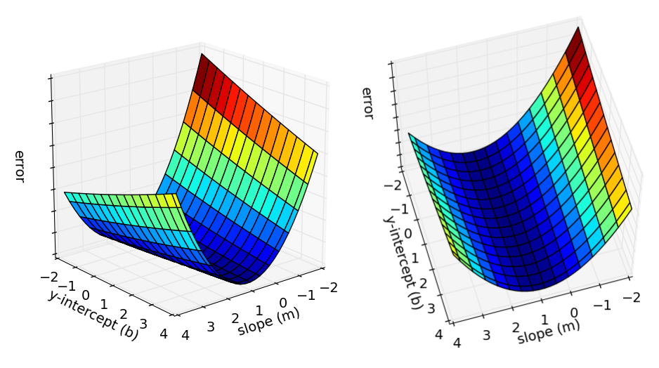
Linear Regression

Slide 18
Start Simple - Gradient Descent
Find Lowest Point for Y=X²

Slide 19
Back to Linear Regression

Slide 20

Gradient Descent

Slide 21
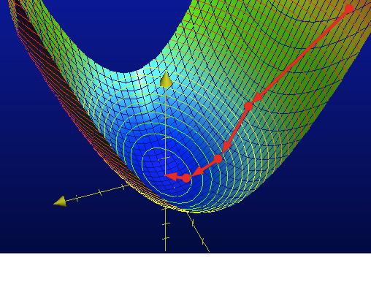
Gradient Descent

Slide 22

Problem with Gradient Descent

Slide 23


Slide 24
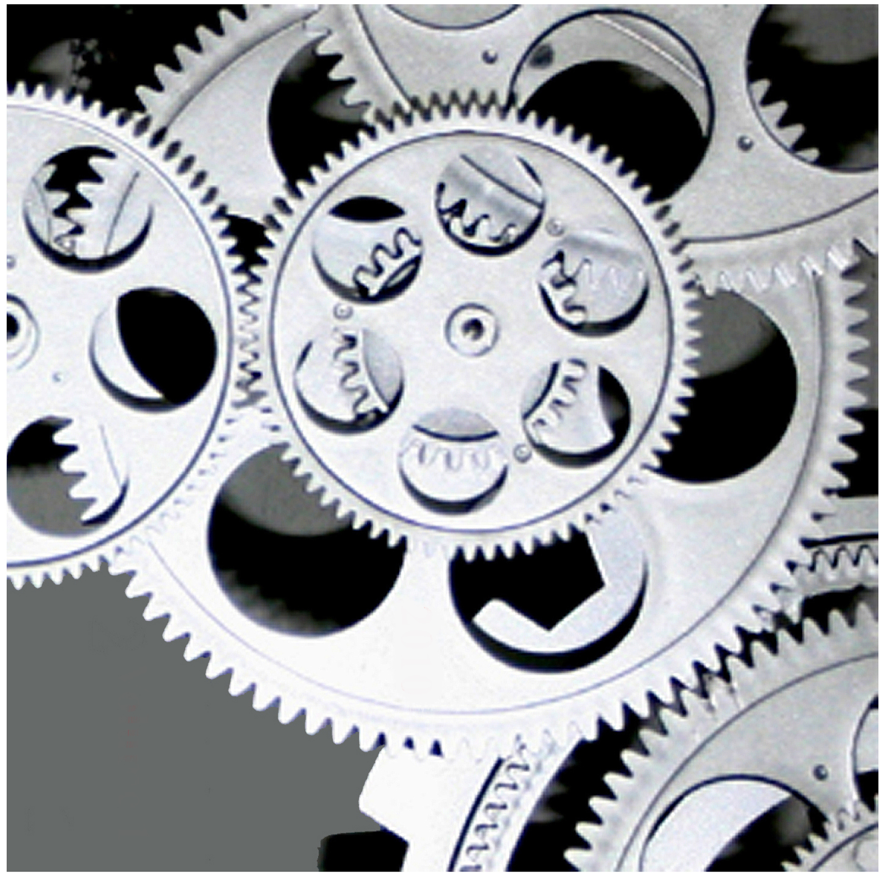
Running at Scale?

Slide 25
Two Types of Scaling?

Slide 26
Two Types of Scaling?
Vertical
Horizontal

Slide 27
Another Two Types of Scaling?

Slide 28
Another Two Types of Scaling?
Weak
Strong

Slide 29
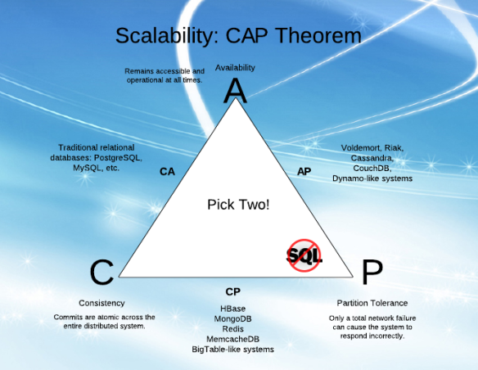
CAP

Slide 30


Slide 31
Why Spark?
Spark is a parallel data analytic platform, with built-in, scalable ML algorithm
Easy to use
Scales to large datasets
Hot in the industry

Slide 32
Power of Spark
o: Petrol
o: Diesel
Horsepower
Weight of Car (kg)
model = SVMWithSGD.train(MLUtils.loadLibSVMFile('filename'), numIterations) model.predict(Array(100,1100))
Works with 100 row dataset, and with 1 Billion row dataset

Slide 33
More Spark

Slide 34
Lambda function in Python
def myfunc(x,y):
return x+y
rdd.map(myfunc)
<==>
rdd.map(lambda x,y:x+y)

Slide 35
Single RDD Transformation
filter
sample
map/flatMap
distinct

Slide 36
Two-RDD Transformations
union
intersection
subtract
cartesian

Slide 37
Actions
count/countByValue
take/takeOrdered/takeSample
top
collect
foreach
reduce
fold
aggregate

Slide 38
Key-value Pair Transformations
reduceByKey/groupByKey/combineByKey
mapValue/flatMapValue
keys/values
sortByKey
join/leftOuterJoin/rightOuterJoin
subtractByKey

Slide 39
Key-value Pair Actions
countByKey()
collectAsMap()
lookup(key)

Slide 40
Dataframes

Slide 41
Demo

